Slide 1
Final Case Study
By: Ashley Cervantes

Slide 2
Introduction
Thinking about common complaints with management companies in Champaign/Urbana, we think of problems such as problems with maintenance, expensive rent, intrusive tours, stealing packages
But does this also happen within other universities' management companies as well?
In this case study we compare management companies in Brigham Young University(BYU), Pennsylvania State University(PSU), and University of Illinois Urbana-Champaign(UIUC) to see if there are any similar complaints or if it just a University of Illinois management companies kind of thing.

Slide 3
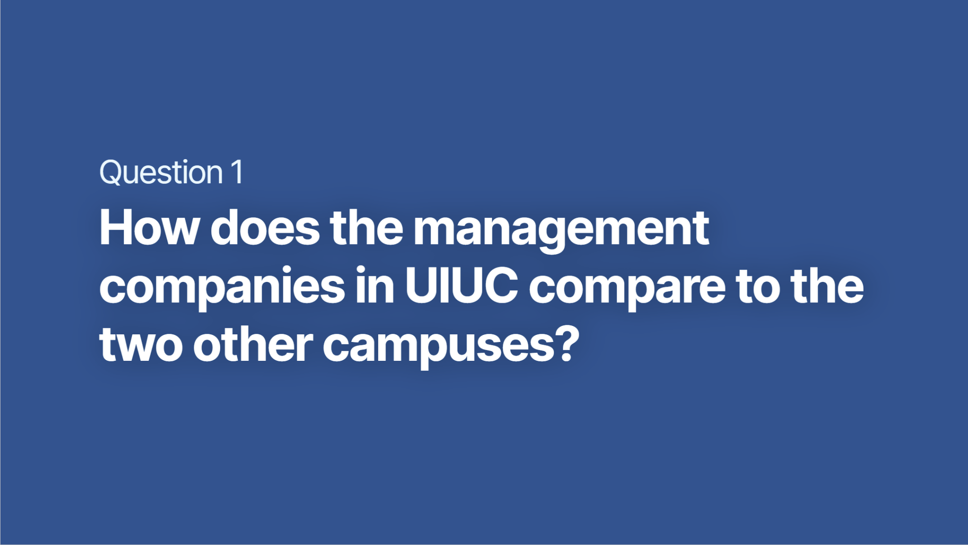

Slide 4
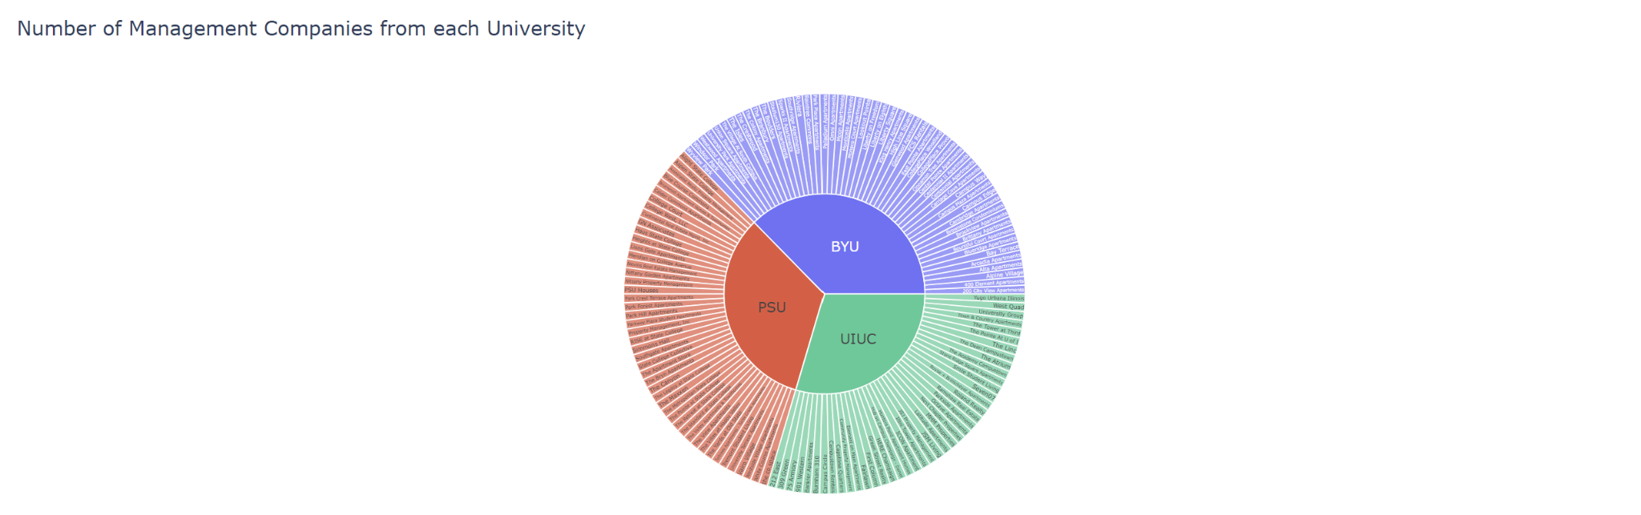
BYU: 53 Counts of Management Companies
PSU: 47 Counts of Management Companies
UIUC: 42 Counts of Management Companies
BYU: About 35,000 students enrolled
PSU: About 88,000 students enrolled
UIUC: About 56,000 students enrolled
As seen in the sunburst, BYU has the most counts of management companies but with the smallest count of students enrolled
Surprising to see that UIUC has the least counts of management companies with more students enrolled compared to BYU
Notes:
Sources for these findings in the last slide

Slide 5
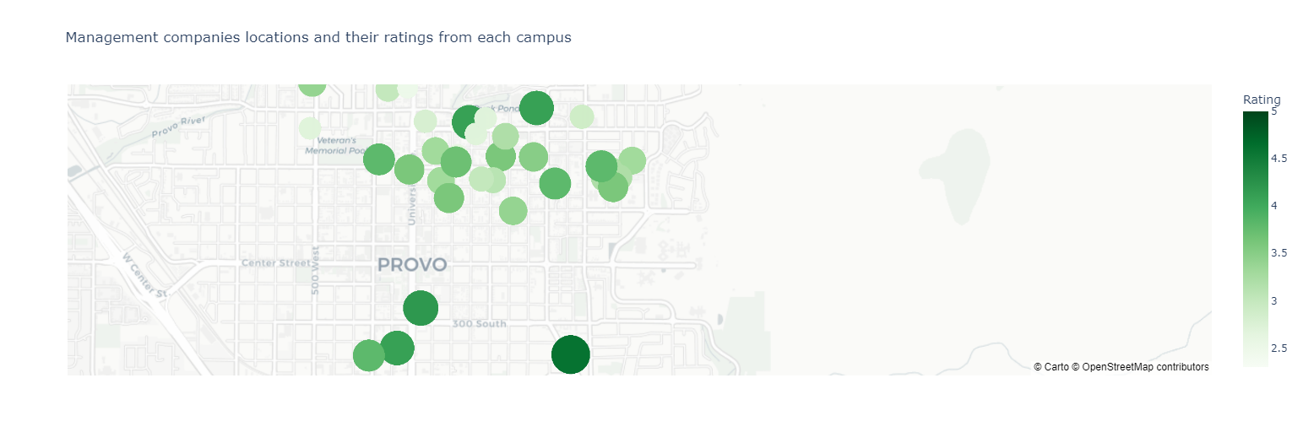
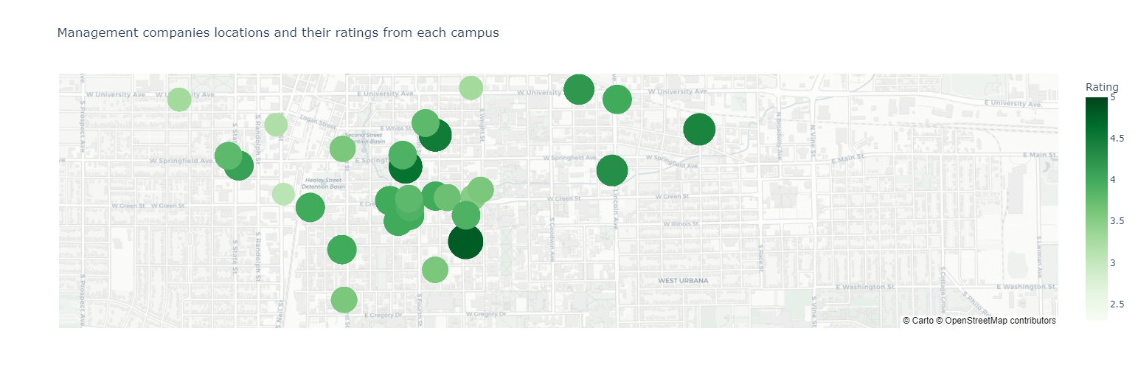
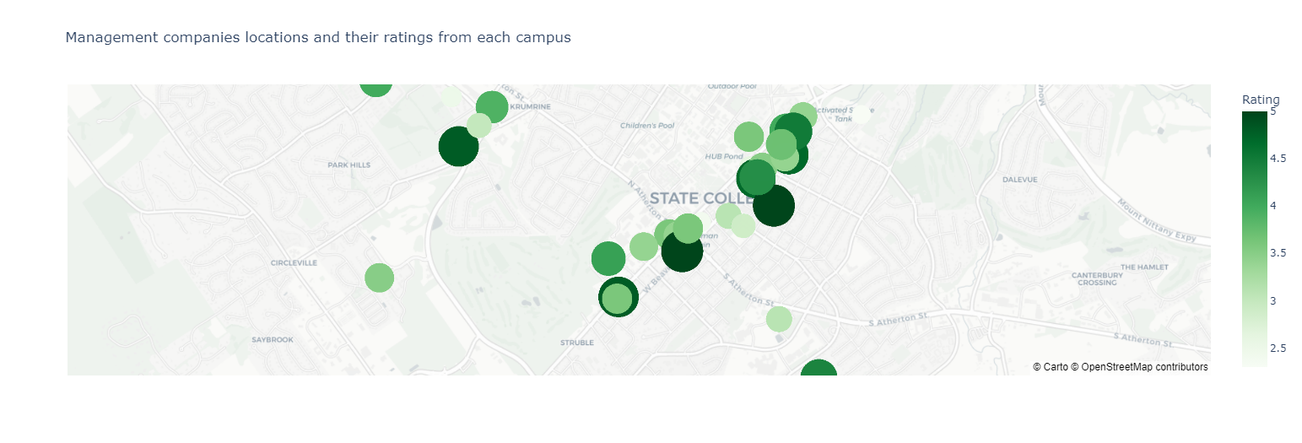
BYU
-All three have businesses close to the location of their appropriate campus
-BYU has an interesting trend where lower rating is closer to campus
-PSU has more businesses with higher rating closer to campus compared to BYU and UIUC
UIUC
PSU

Slide 6
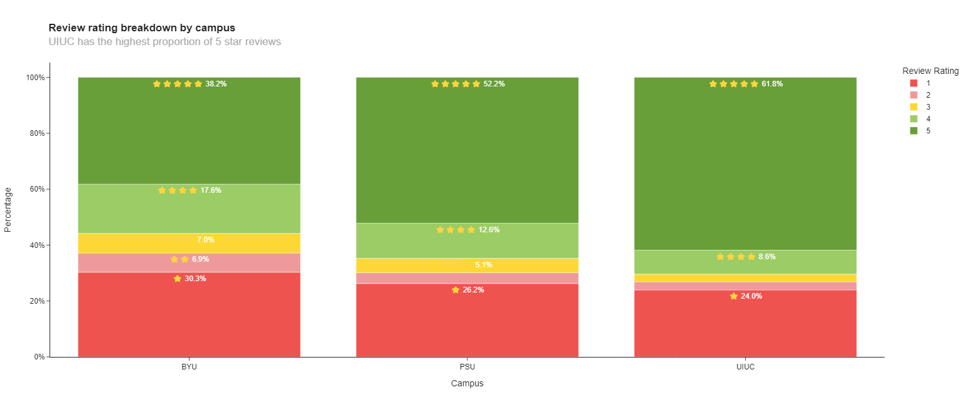
Here is a bar graph that shows the percentages of review ratings from a scale of 1 (being worse) to 5 (being the best). The scale of review ratings are also shown through the number of stars. With all three campuses, UIUC has the highest proportion of 5-star ratings compared to BYU and PSU.

Slide 7
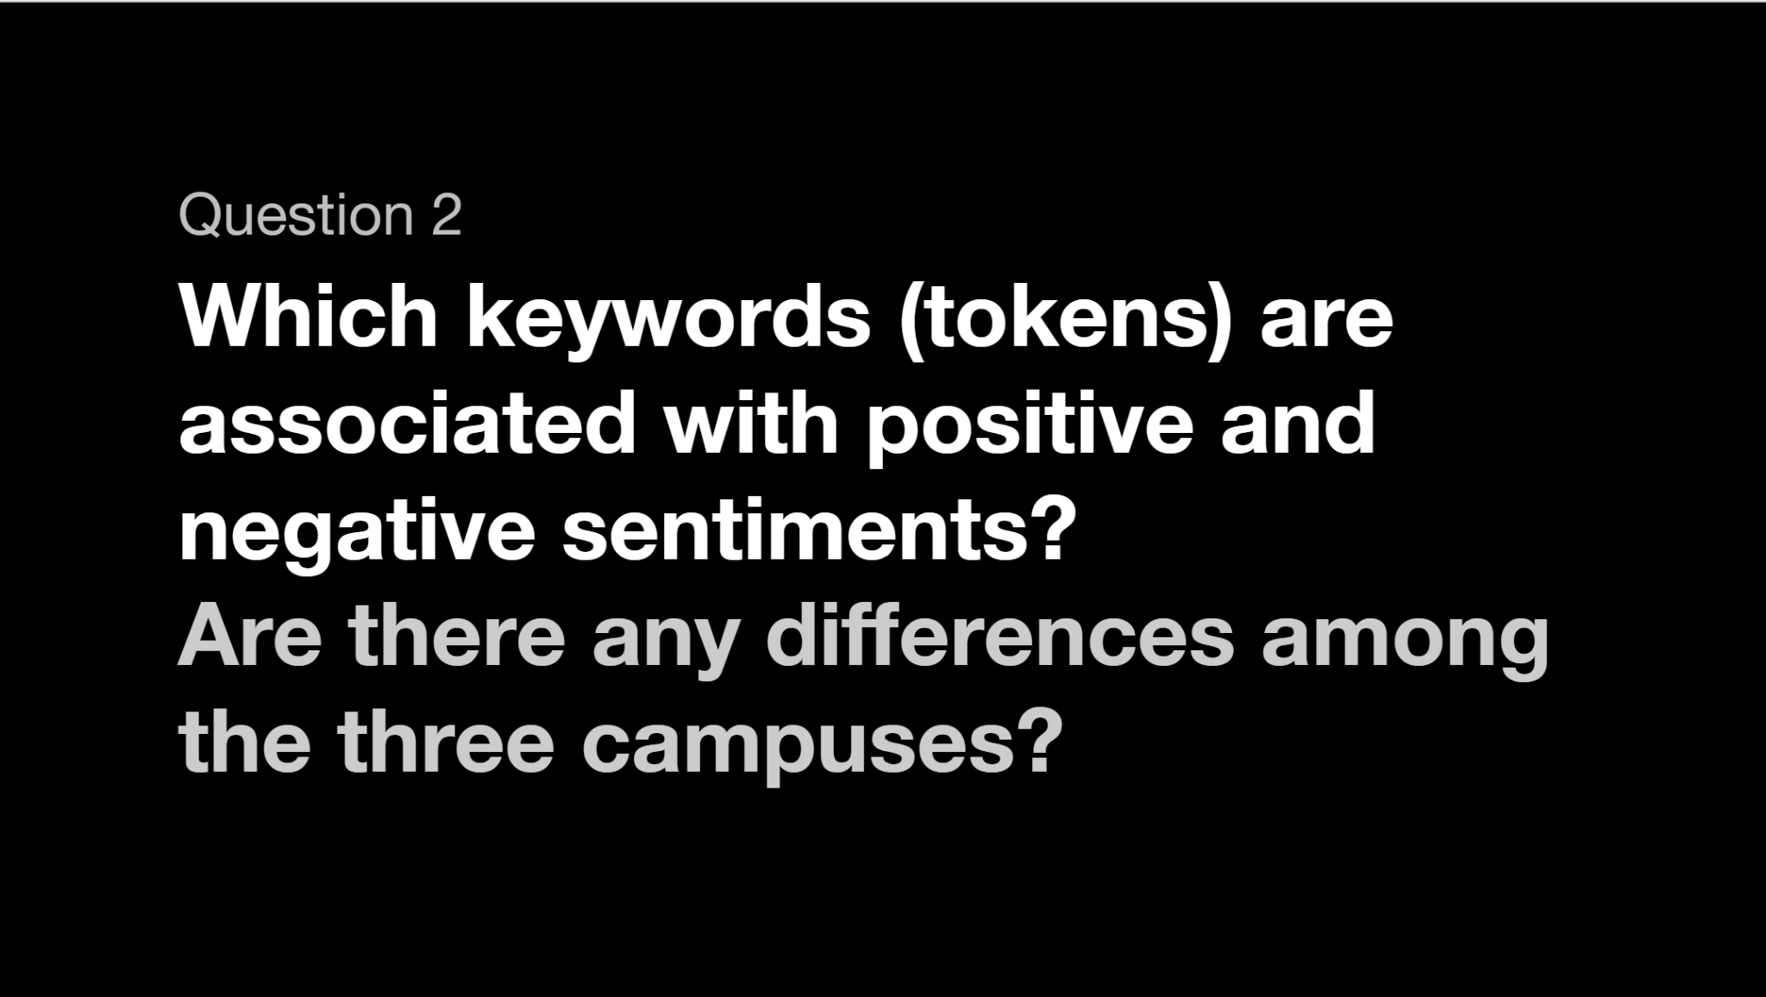

Slide 8
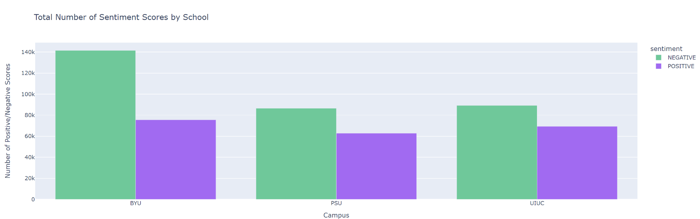
Here we have counts of both negative and positive sentiment score from each campus. Green is negative and purple is positive. BYU had the most count of negative sentiment scores. However, throughout all campuses, they all had the about the same percentage of positive sentiment scores.

Slide 9
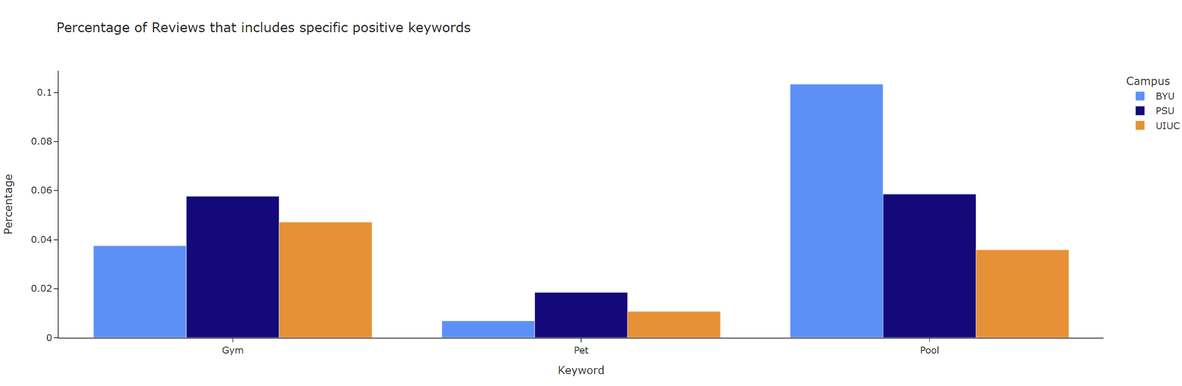
Looking into all reviews, we look into specific positive keywords such as gym, pet and pool. Light blue indicated BYU, dark blue indicates PSU and orange indicates UIUC. One significant positive word with the most percentage is pool from BYU. PSU the highest percentage of positive keywords were gym and pool. Lastly, the highest percentage of positive keyword in UIUC was gym.

Slide 10
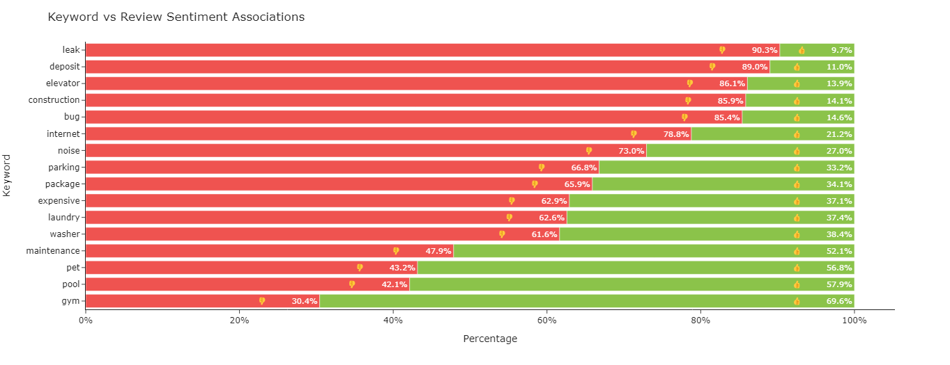
Looking over overall keywords in the reviews, we have percentages of each keyword that indicate if it was a positive keyword or a negative keyword. The highest percentage of a negative keyword in the review was leak, with a 90.3%. The highest percentage of a positive keyword in the review was gym, with a 69.6%.

Slide 11
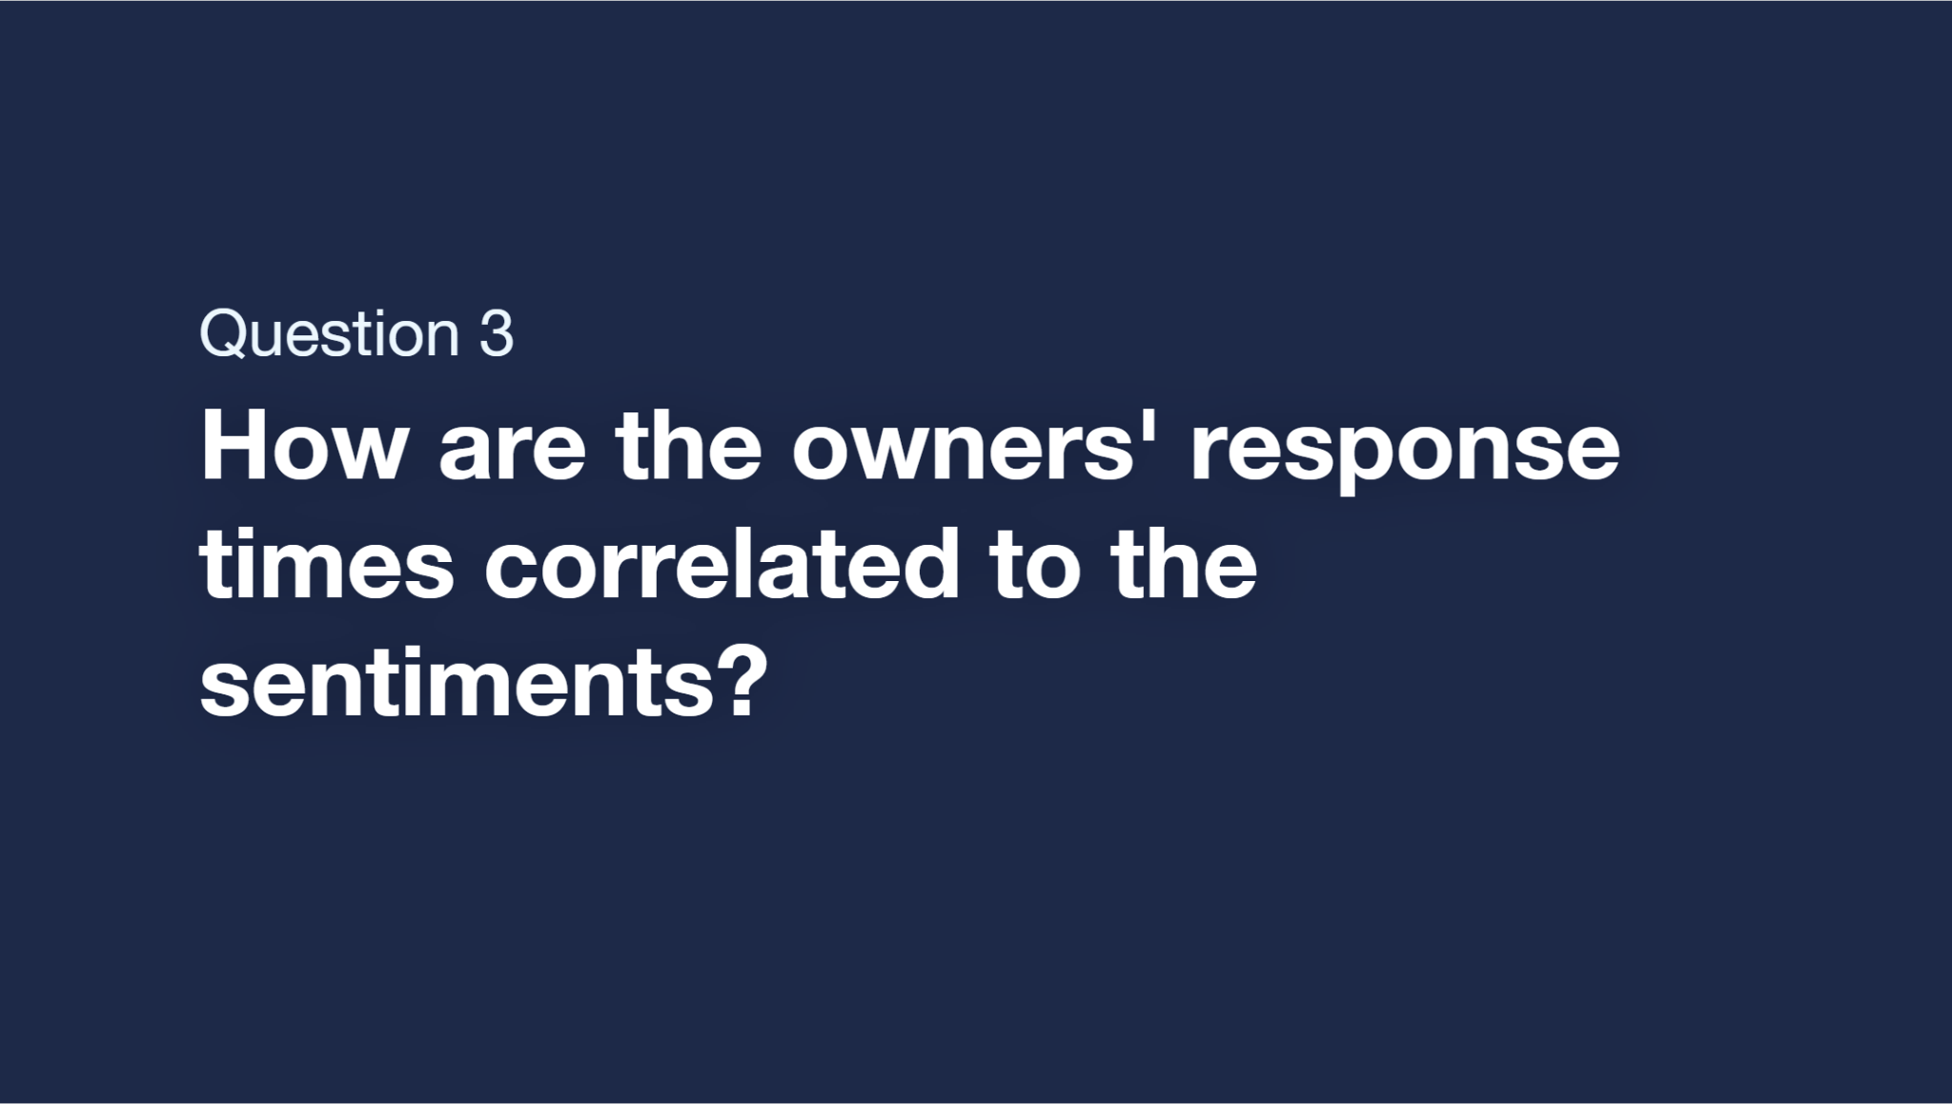

Slide 12
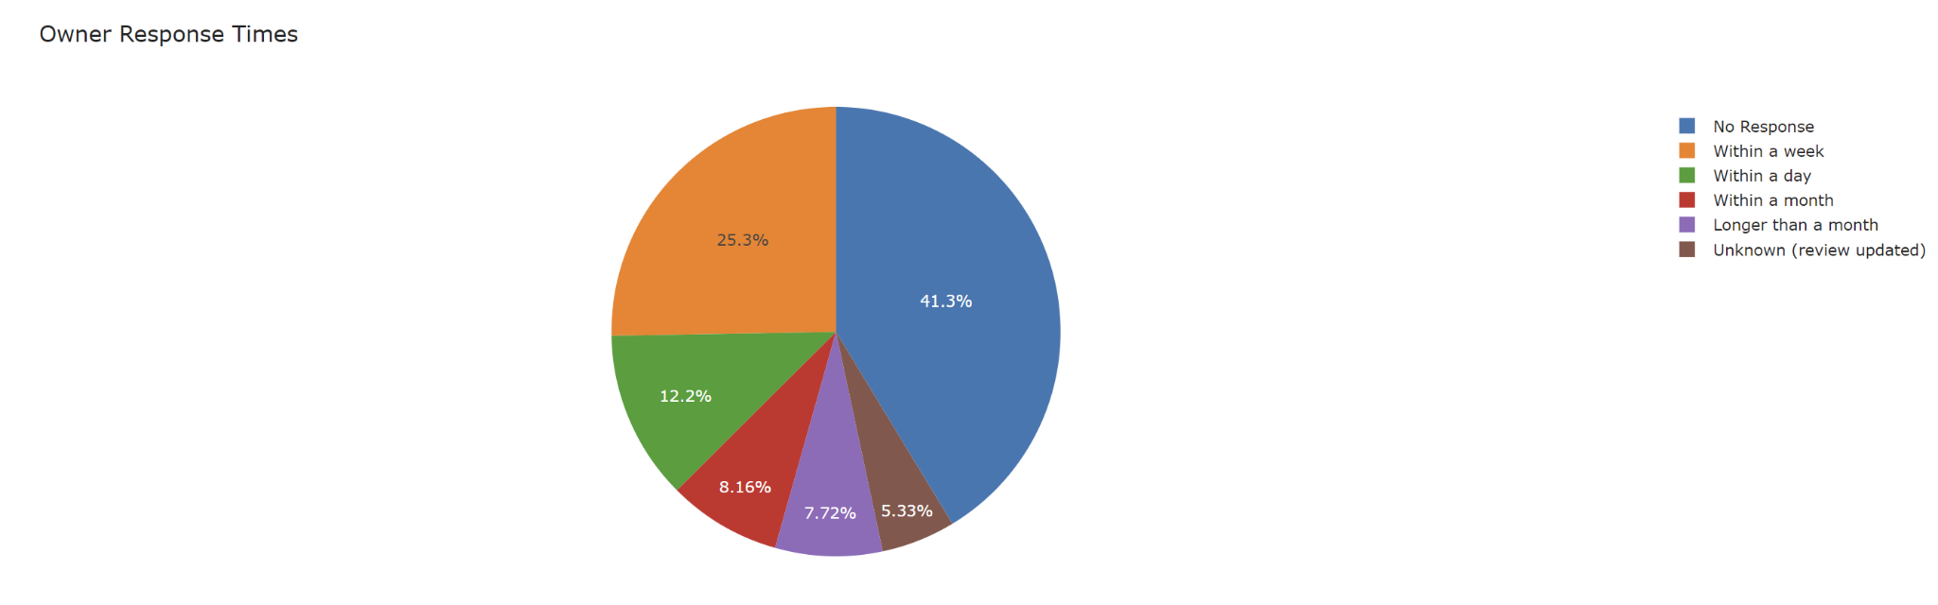
Here we have a pie chart of the percentage of each type of owner's response to an issue within all campuses. The most percentage was “No Response” with a 41.3%.

Slide 13
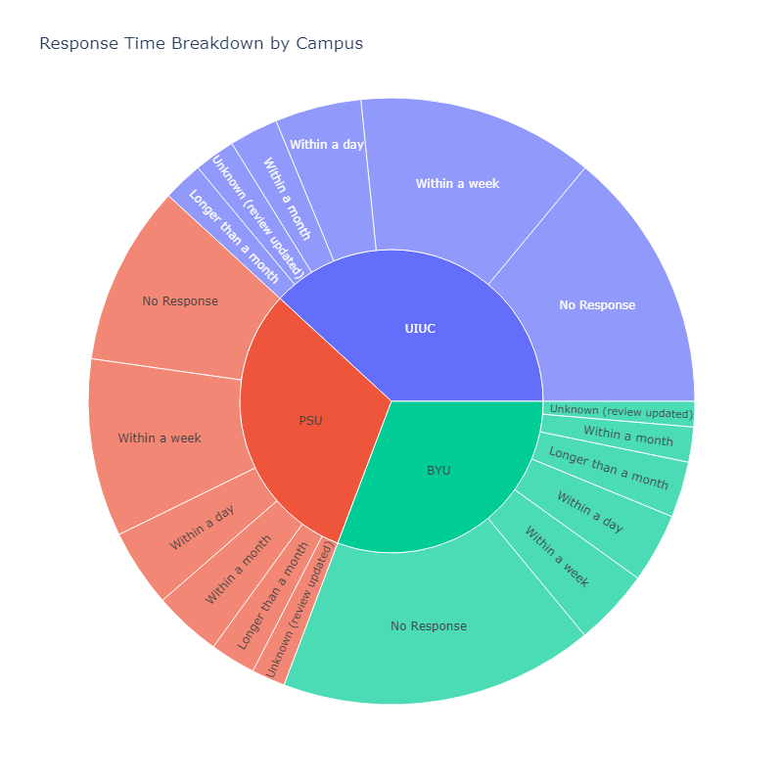
Here we have another pie chart with owners response but within each campus.
BYU has a tendency to not response, “No Response”
PSU has a tendency to either not response or respond within a week
UIUC also similar to PSU but has a bit higher tendency to not respond

Slide 14
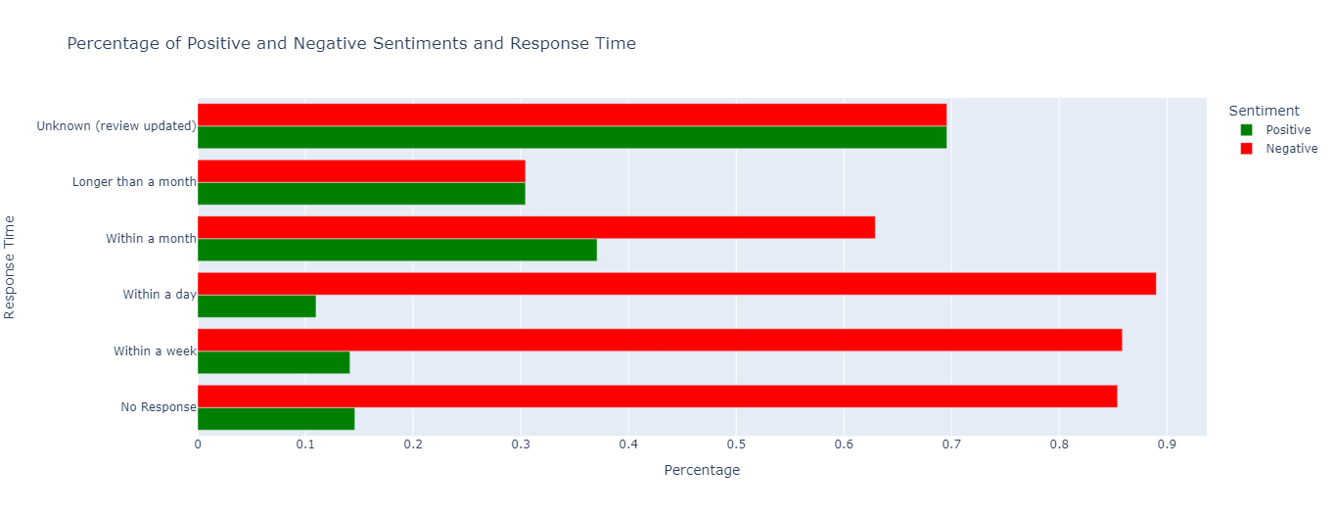
When comparing both positive and negative sentiments from the review, owners tend to responded to negative sentiments within a day whereas with positive sentiments they tend to respond within a month and or if the review has been updated.

Slide 15
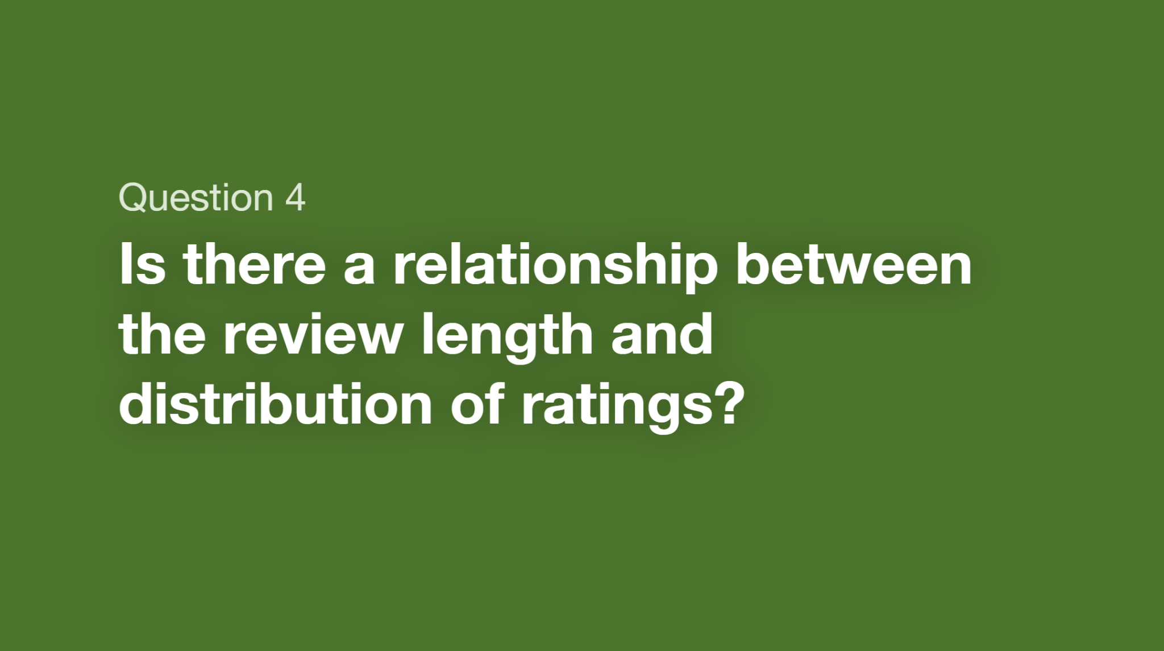

Slide 16
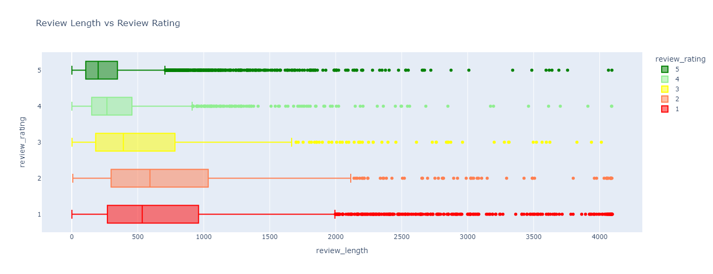
Comparing review length (amount of characters in the review) and review rating it has been seen that 5-star ratings had a smaller length and a smaller range compared to other star ratings. Surprisingly, 2-star ratings had the largest range of review length.

Slide 17
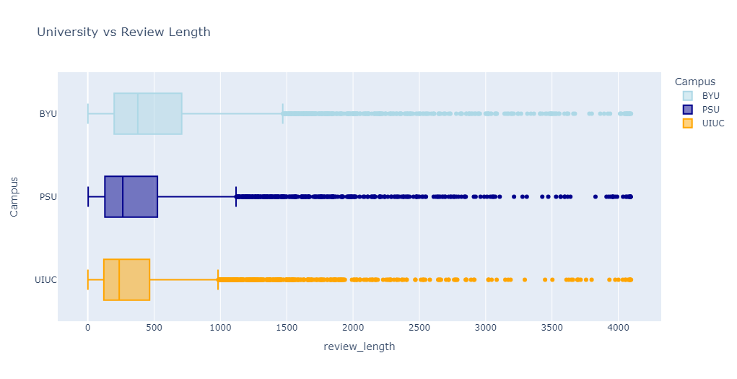
Now, comparing between campuses, BYU had the largest range of review length compared to PSU And UIUC. UIUC had the smallest review length and small range of review length.

Slide 18
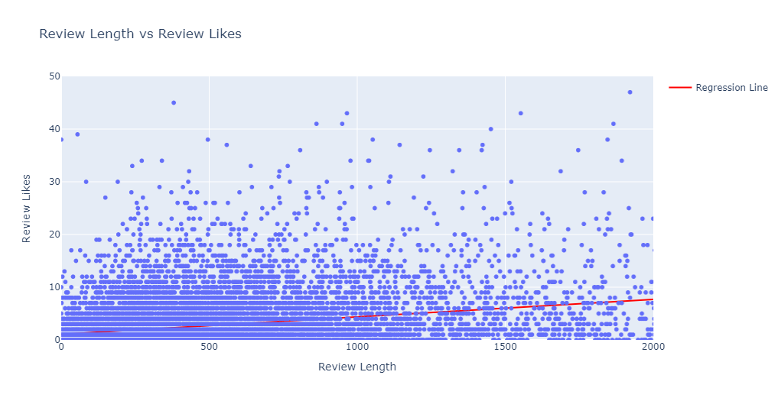
Here we have a scatter plot of each review length and is appropriate likes of that review. The regression line is a line that sees if there is correlation between the two. Since there is not a clear line of dots near the line, that means that there is no correlation between review like and review length.

Slide 19
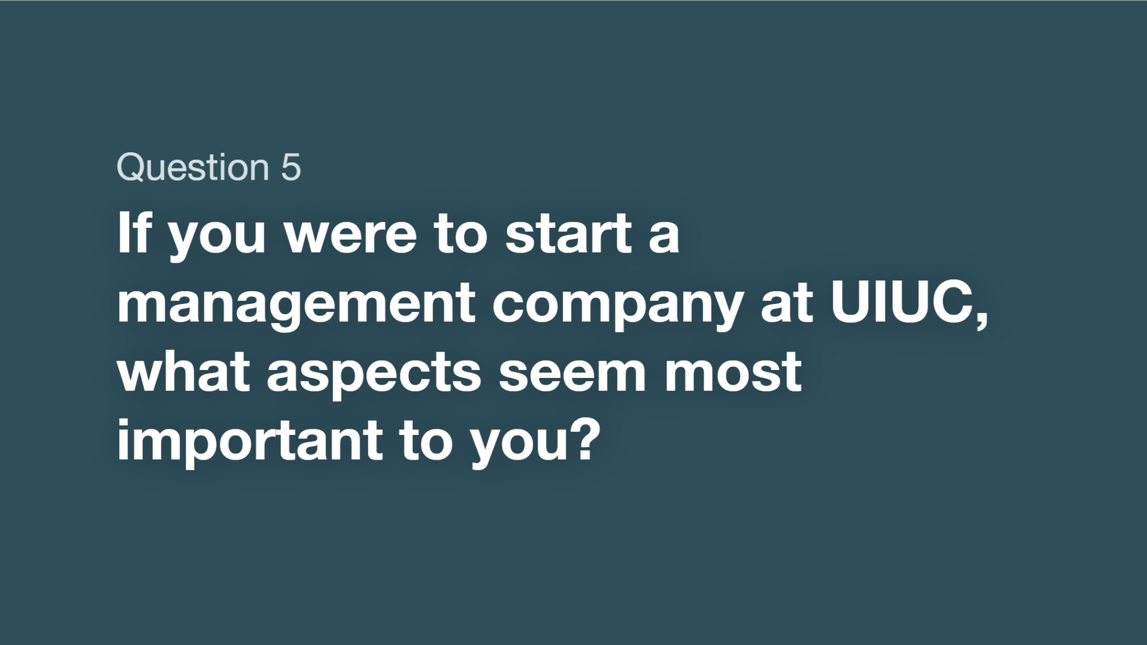

Slide 20
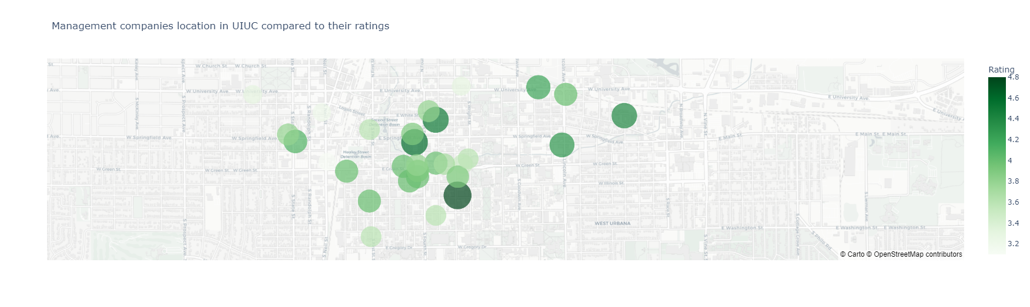
#1 Location
Most as you can see are close to campus (red mark is the Main Quad), however most seem to be more on the side of Champaign rather than Urbana
As shown above, most management companies that are relatively close have a rating of 4 or above
Darkest green dot is The Hub with a rating of 4.8/5
With that, I would put my management company on Urbana Side to have more variety of location and close to the Main Quad to potentially receive high ratings such as The Hub

Slide 21
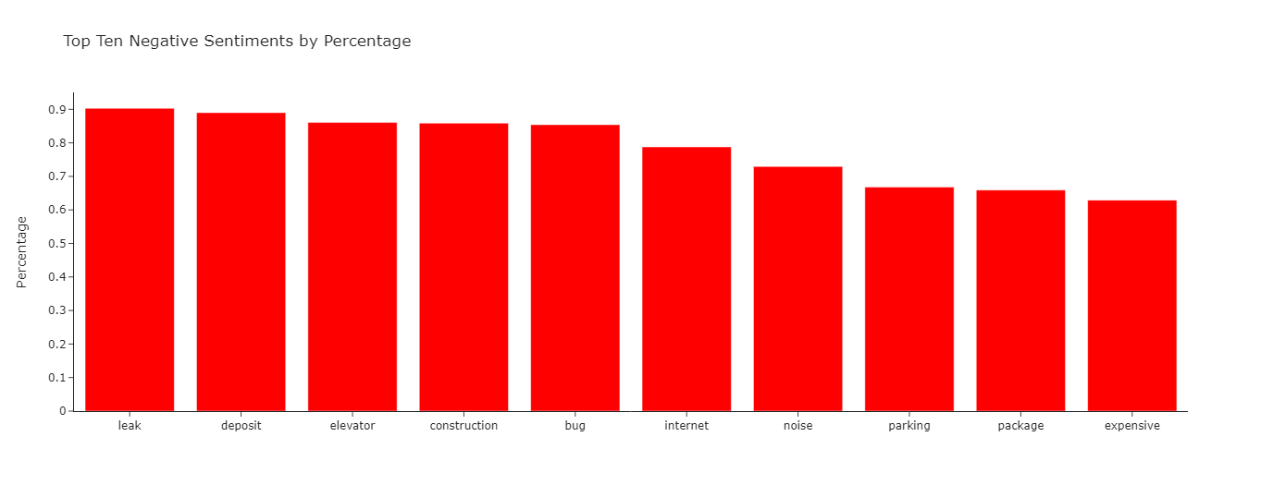
#2 Negative Sentiments
Here is a bar chart that
I would focus on these negative sentiments and would like to decrease them especially in the areas of maintenance issues like leak, Internet, elevator, construction and other issues with deposit being too expensive
I would do this by having well maintenance team to fix these problems as soon as the problem has been announced,Issues with deposit and the expensive is going to depend on living space With security, I would put cameras around the building have secured mailbox for when packages arrive.

Slide 22
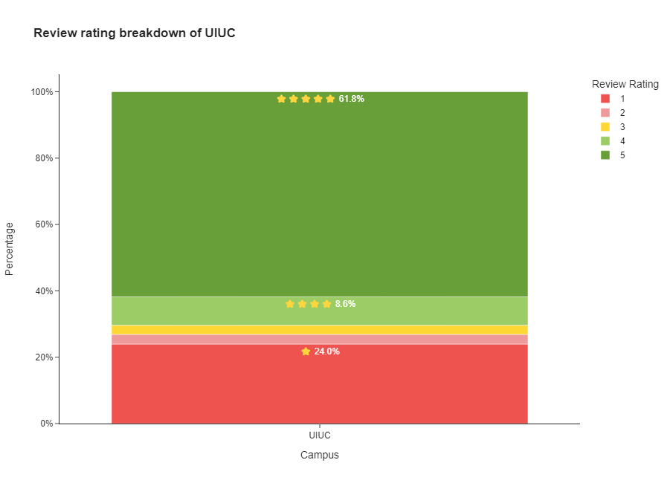
#3 Review Rating
This chart show the general review rating breakdown of UIUC
5 star rating of 61.8%
4-star rating of 8.6%
3-star rating of
2-star rating of
1-star rating of
If I were to have a management company in UIUC, I would like to hope that my customers give more 4 or 5-star ratings so that 2 or lower star ratings are smaller.
These ratings are important especially for new people looking for an apartment to live.
Lower rating —> no business
Higher rating …> more business

Slide 23
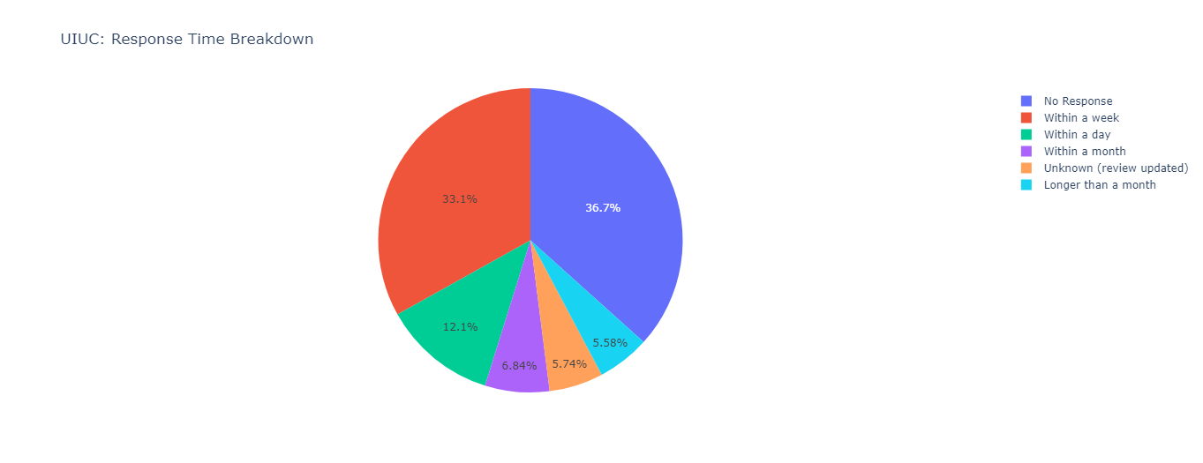
#4 Owners Response
Owners at UIUC as a whole have a tendency is to either not respond or respond within a week. I would like to have a team to respond within a day or at best within a week. This allows the company to no only get the issues resolved but as a whole leaves customers happier to knowing that the company cares.

Slide 24
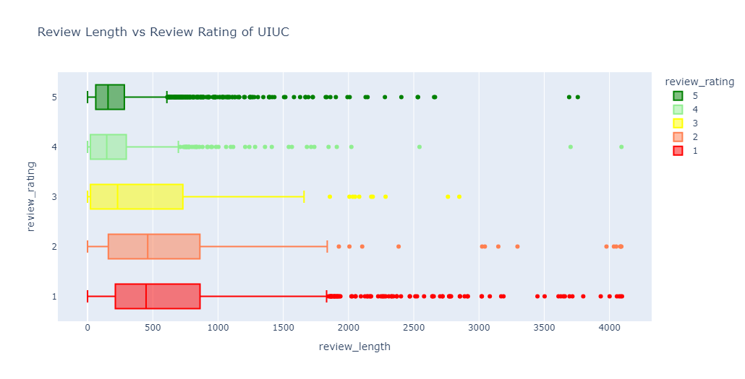
#5 Review Length
Again, looking more specifically within UIUC and looking into review length and review rating, there's seems to be a tendency to have longer review lengths with lower ratings. This shows that the customers are more into detail when a company does not fulfill their wishes. I would like to get more 5-star ratings with shorter review length, since new upcoming customers do look into reviews before getting connected with any company.

Slide 25
Interesting Insights #1
One thing that I found interesting about the response time between each campus was the fact the UIUC and PSU have very similar output with every single response time. It makes me wonder if management companies within the same conference (like BIG 10) have similar management company style.

Slide 26
Interesting Insights #2
Again, I was shocked to see that there were more management companies within a university that has a smaller total student enrollment. I would have thought, especially the size of the UIUC campus, that there would be more available management companies in the area.

Slide 27
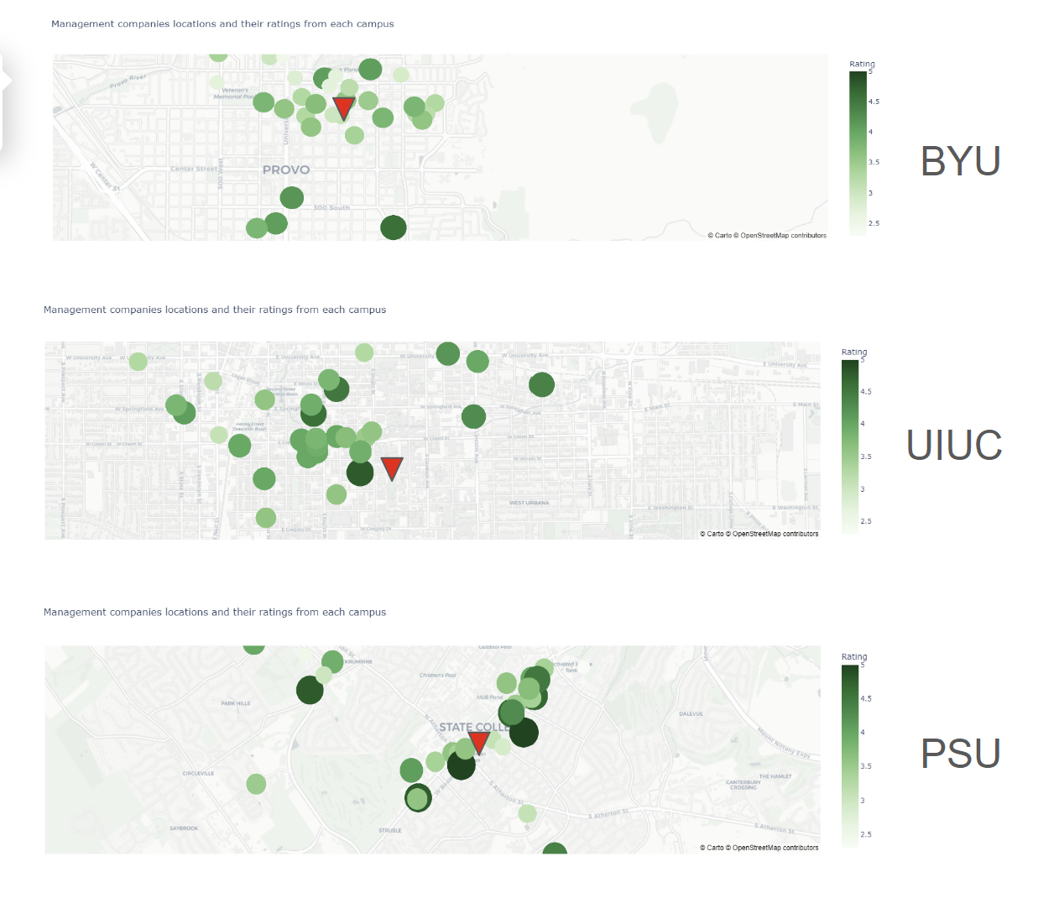
Interesting Insights #3 -
Another interesting insights that I found was that compared to PSU and BYU, UIUC has more management companies that are a bit farther away than on campus. Again, what made me intrigue the most about the location of the management companies from BYU is that lower ratings were closer to campus. It makes me wonder if that may be the reason to why they have lower 5-star proportion review ratings, since students are more available in those areas with lower ratings.

Slide 28
Summary
Overall, UIUC is not the only university with similar complaints with management companies. Most visuals show that BYU has the more complaints with management companies through more negative sentiments scores in the review, lower percentage of 5-star ratings and having no response from owners. I also found that PSU and UIUC has almost neck to neck the same percentage with every type of complaint with management companies such as review length, owners response, and review rating. If UIUC wants to improve with their management skills in these management companies, they should have more available places in Urbana, respond to customers issue, focus on increasing positive sentiments scores, a continuing having 5-star review rating percentages so that customers can go back and/or stay with these management companies.

Slide 29
Colab Notebook + Sources
https://drive.google.com/file/d/1bx61kqVeDPQ-4UBOhCsrCYJuVcBAeYYz/view?usp=sharing
https://news.illinois.edu/view/6367/2035013088
https://www.byu.edu/facts-figures
https://www.psu.edu/news/academics/story/penn-states-enrollment-remains-strong-2023/#:~:text=Overall%2C%20University%2Dwide%20enrollment%20for,the%20commonwealth%20and%20its%20citizens.

